Slide 1
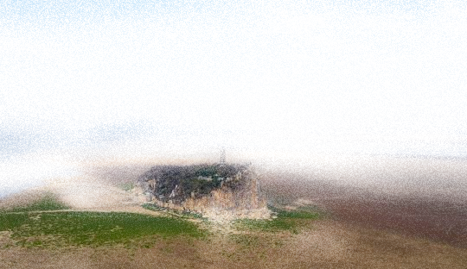
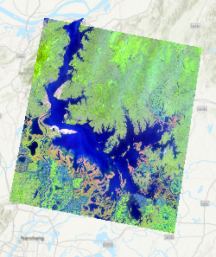
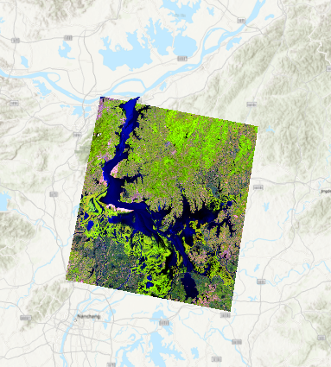
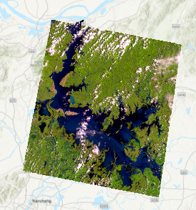
Lake Poyang: Measuring Change
a small change in pixels = a large change for the big picture.
Jessica mcphaul

Slide 2

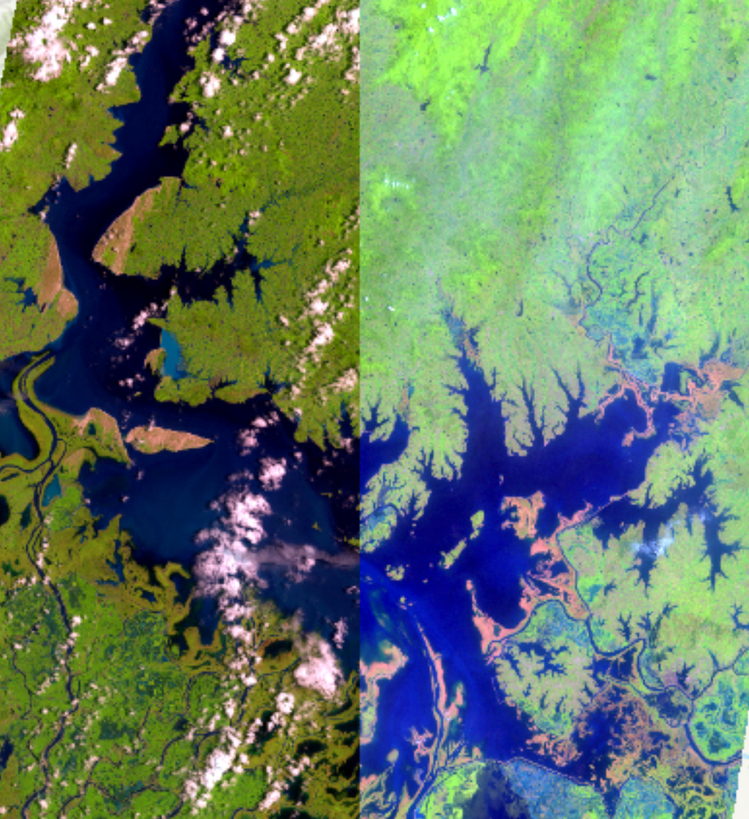
1984 2001

Slide 3

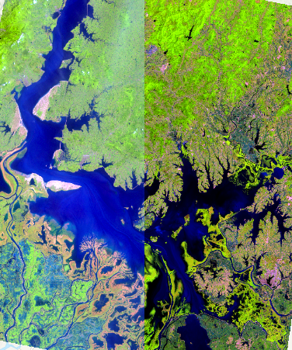
2001 2014

Slide 4
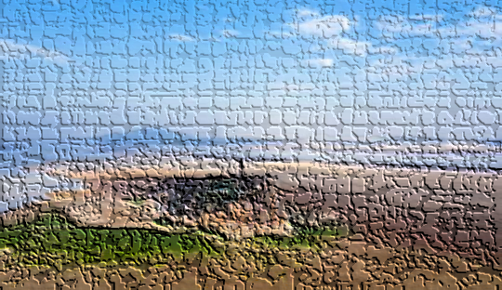
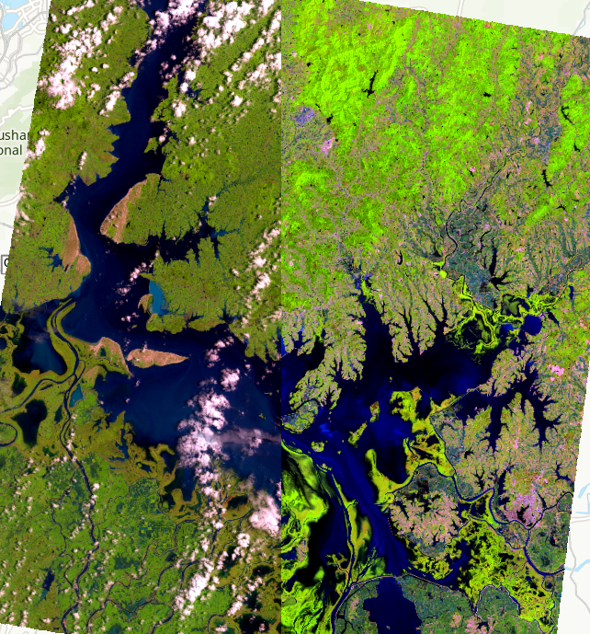
1984 2014

Slide 5
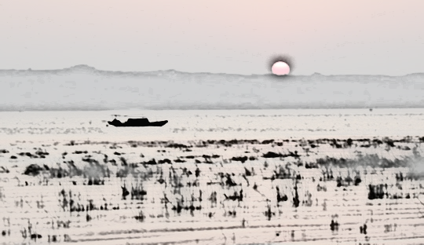
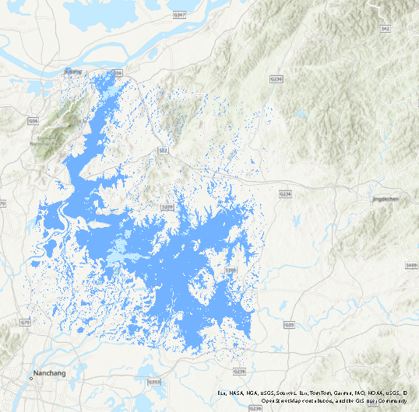
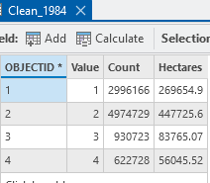
1984

Slide 6
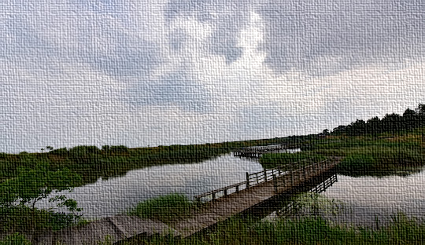
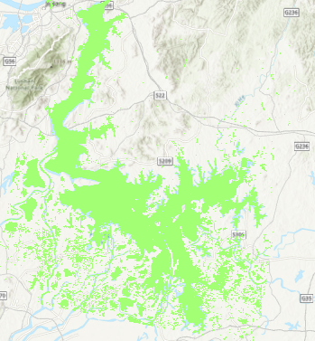
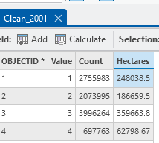
2001

Slide 7
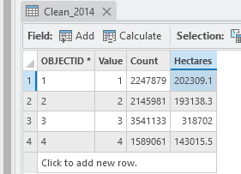
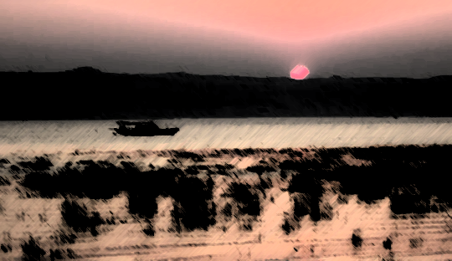
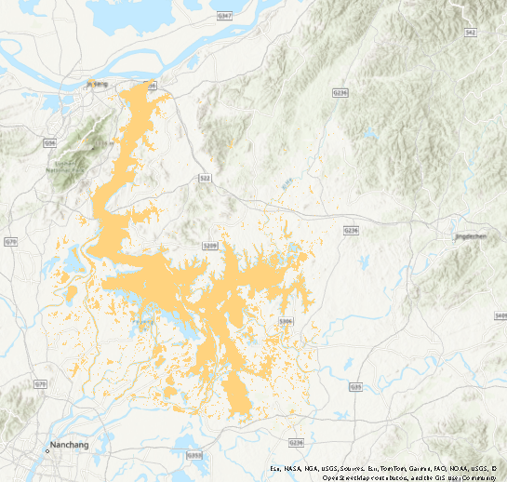
2014

Slide 8
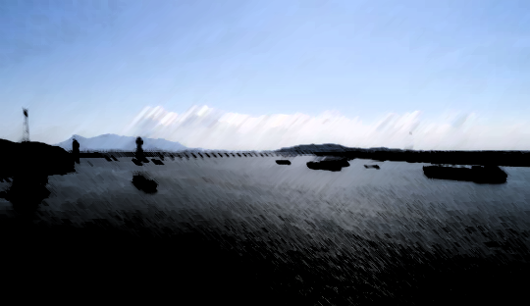
Describe the Total Area Lost Between Years and the Loss Per Year
Total Area:
2001 Area: 2,480,385.5 hectares
2014 Area: 2,023,091 hectares
1984 Area: 1,269,654.9 hectares
Total Area Loss:
From 2001 to 1984:
Loss = 2,480,385.5 - 1,269,654.9 = 1,210,730.6 hectares
Area Loss Per Year:
From 2001 to 2014 (13 years):
Loss = 2,480,385.5 - 2,023,091 = 457,294.5 hectares
Annual Rate = 457,294.5 ÷ 13 ≈ 35,176.5 hectares/year
From 2014 to 1984 (30 years):
Loss = 2,023,091 - 1,269,654.9 = 753,436.1 hectares
Annual Rate = 753,436.1 ÷ 30 ≈ 25,114.5 hectares/year

Slide 9
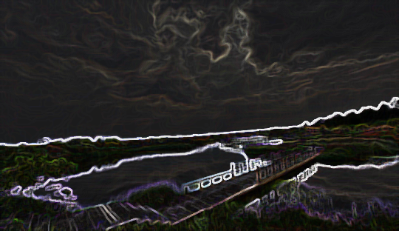
Change in Rate of Loss
The rate of area loss between 1984–2014 (25,114.5 hectares/year) was slower compared to the rate of loss between 2001–2014 (35,176.5 hectares/year).
This indicates an increase in the rate of loss during the more recent period, particularly after 2001
Observations Regarding the Three Gorges Dam
The construction of the Three Gorges Dam in 2008 significantly altered the hydrology of the region. The increased rate of loss between 2001–2014 coincides with the post-construction period, suggesting that the dam may have impacted Lake Poyang's water levels.
The reduced inflow and changes in seasonal flooding patterns likely accelerated water loss in the lake.
The observed patterns highlight the need for further research into the dam's long-term ecological impacts.

